Slide 1
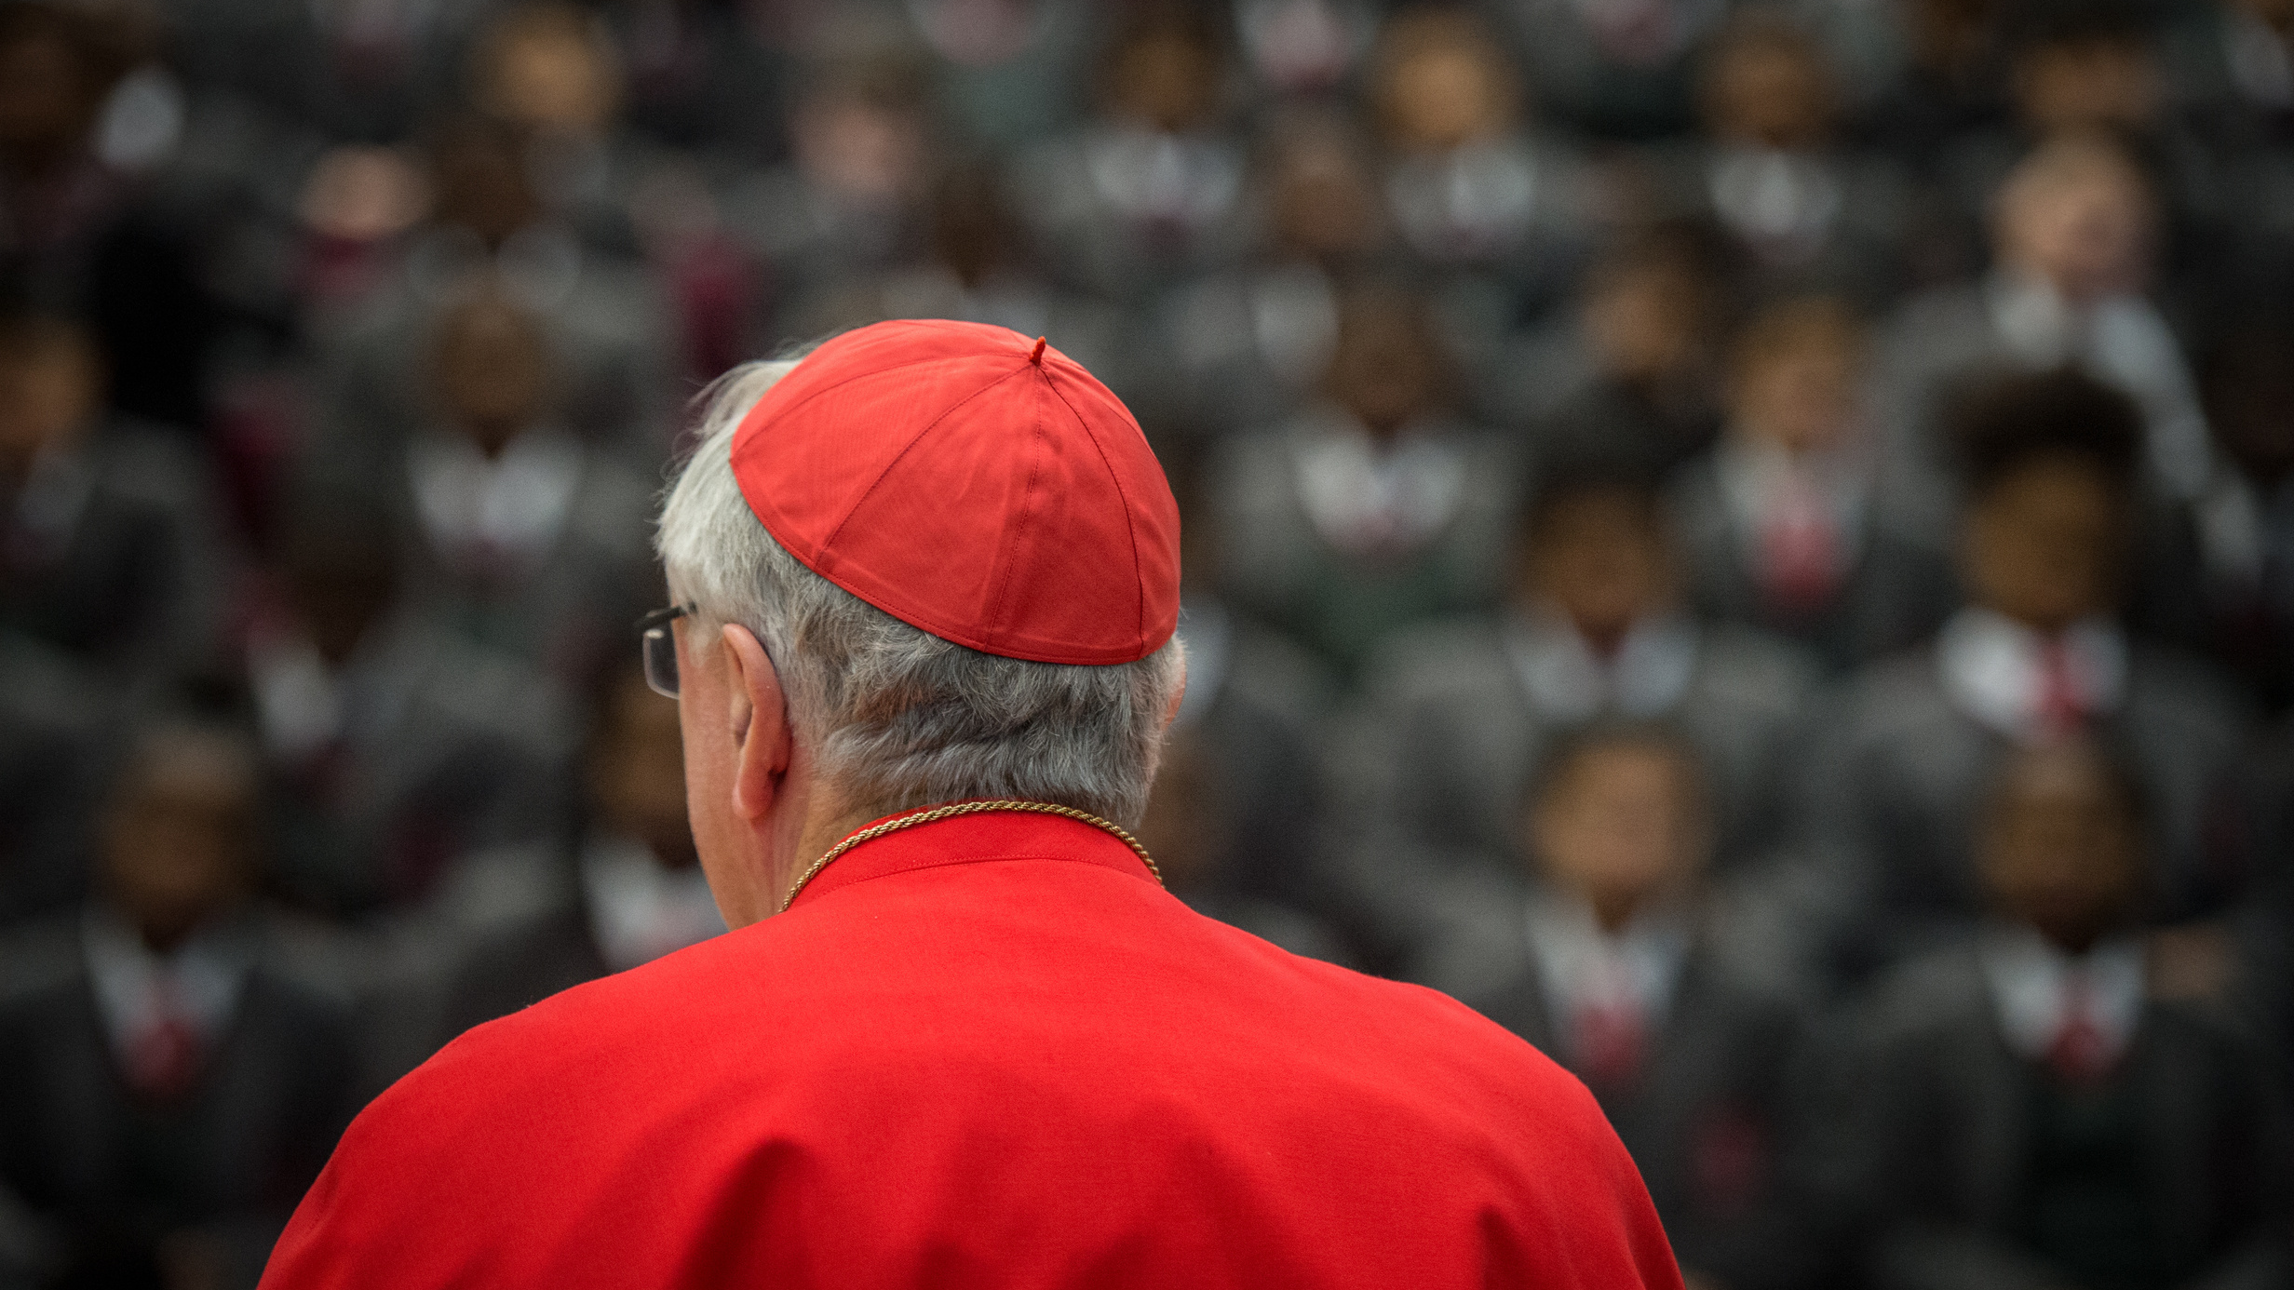
VOCATION
CORE RE MODULE
LESSON SIX
GUEST SPEAKER/
ASSESSMENT PREPARATION

Slide 2
Today we Welcome
Add name of speaker
Write down in your workbook some notes on our speaker today

