Slide 1
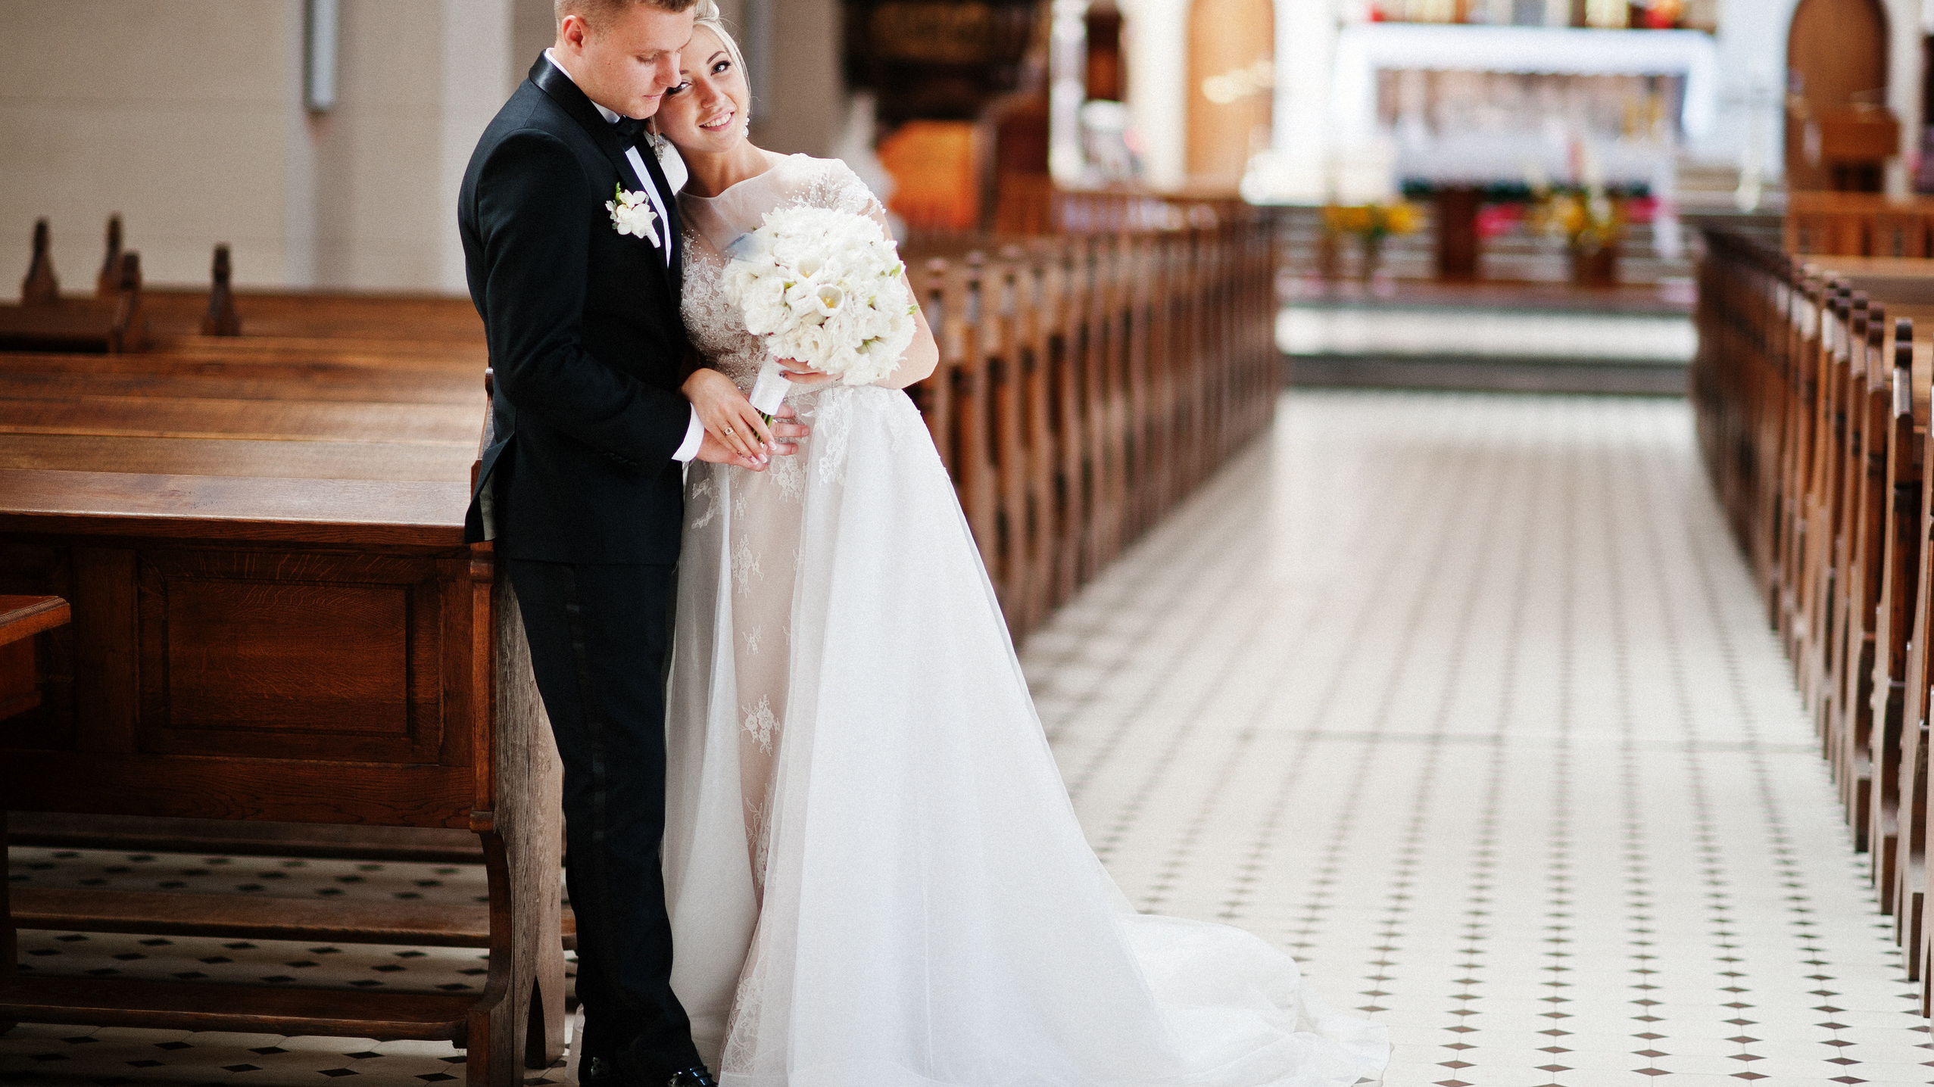
VOCATION
CORE RE MODULE
LESSON THREE
MARRIAGE

Slide 2
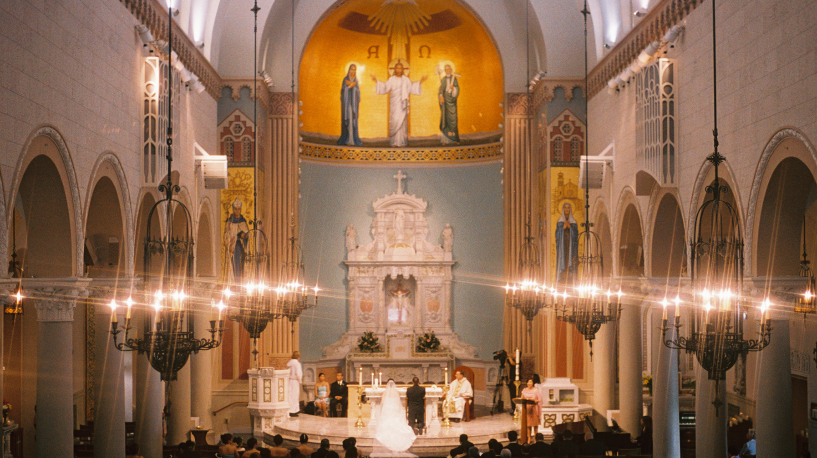
Prayer
God our Father,
we pray in thanksgiving for
the vocation to marriage
and for each couple that you join together in order to make a family.
We ask that every marriage brings each couple closer to you and closer to holiness.
We pray for those who are struggling in their relationships at present,
that they can make it through this tough time and support each other.
We make this prayer through Christ, your Son, our Lord.
Amen.

Slide 3
Learning Objectives
To understand that marriage is a vocation.
To understand why people get married.
To explore the call to love as the central part of marriage, which is at the heart of the vocation.

Slide 4
EMILY & MATTHEW
Watch Emily and Matthew talk on the vocation to Marriage and Family Life.
A Catholic marriage should be life long, fruitful (open to life), permanent and exclusive, whilst also being entered into freely by choice and not coerced (forced).
Marriage involves the ‘call’ of God, which is bound between two people, husband and wife and it is a total gift of oneself.

Slide 5
The Vocation to Marriage
The Catholic Church teaches that marriage is a vocation. We are all called to live a life of love and holiness through the gift of ourselves to others. Marriage, therefore, is more than just a legally binding document that is signed on the day of the wedding.
A Catholic marriage should be lifelong, fruitful (open to life), permanent and exclusive (only that person), whilst also being entered into freely and consensual and not coerced (forced).
Married life is a process of growth, in which each spouse is God’s means of helping the other to mature… Fostering growth means helping a person to shape his or her own identity. Love is thus a kind of craftsmanship…At every new stage, they can keep “forming” one another. Love makes each wait for the other with the patience of a craftsman, a patience which comes from God.
AL 221

Slide 6
Catholic Marriage
Marriage is one of the Seven Sacraments, which means that the vows made in the wedding ceremony are not only in the sight of God and the Church, but with God. It’s a sign of love for Christ, as much as it is for the other person.
The purposes for Catholic marriage are ultimately:
Sanctification of the spouses to grow in holiness.
For the procreation and education of children.
Marriage is not only the building of a relationship between spouses,
but it’s also about building a home and family.

Slide 7
‘Love and honour each other as long as you both shall live’
Marriage is at times a difficult vocation to live and it demands self-sacrifice, as each person gives themselves freely to each other, just like Christ’s sacrifice on the cross. The other person comes first, ‘love and honour each other as long as you both shall live’ (The Order of Celebrating Matrimony #60).
‘Love is therefore the fundamental and innate vocation of every human being’.
ST POPE JOHN PAUL II

Slide 8
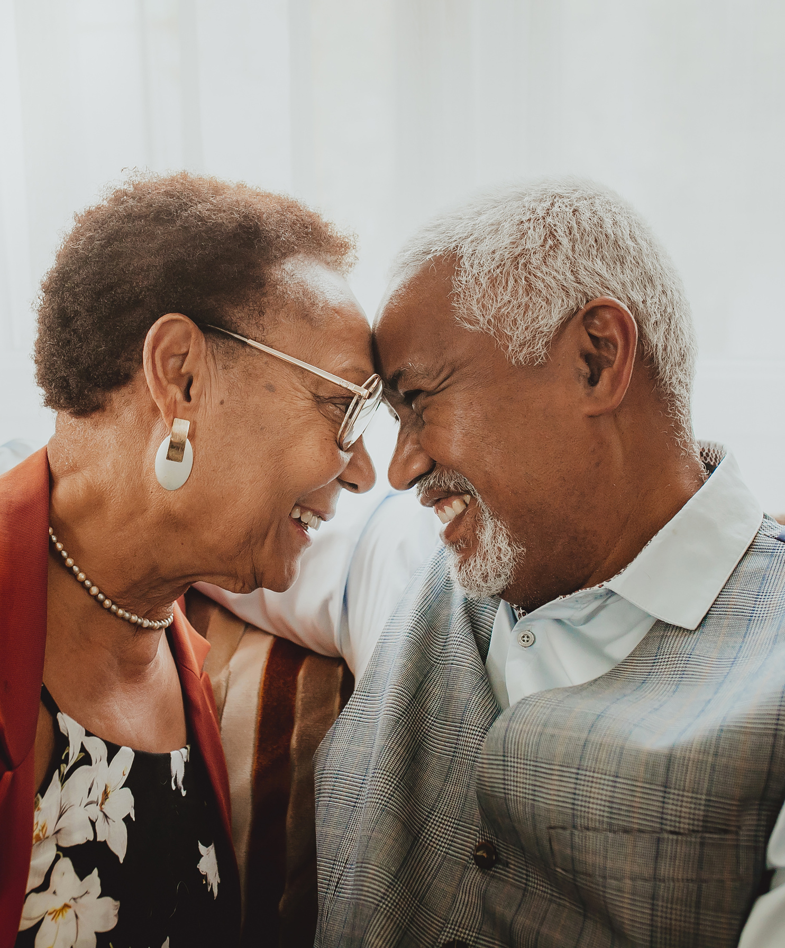
Task
A Catholic marriage should be life long, open to life and exclusive.
Discuss each of these and explain which one you think is most important and why.

